Slide 1
AVL Trees
Youssef Yousri-222117

Slide 2
intro
What is AVL tree and Difference between AVL Tree and normal binary tree
Most important Property

Slide 3
AVL
It is named after the inventors Adelson Velsky and Landis
It is self balancing binary tree

Slide 4
Most important Property
Balancing factor
Perform fixes after insert and delete
O(log n) insert, search and delete

Slide 5
Balancing factor
Height
Most difference in balancing factor between nodes

Slide 6
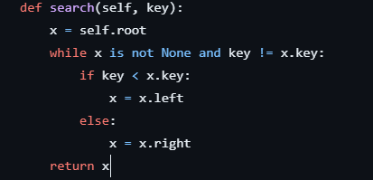
Search
Same as normal binary tree

Slide 7
Insertion and delete
Insert like normal binary tree
fixes

Slide 8
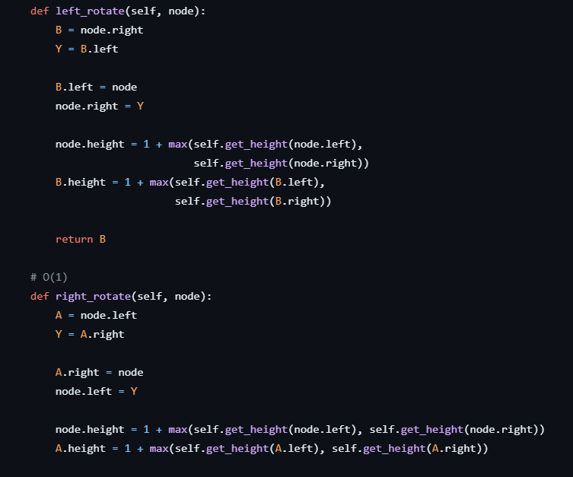
Left and right rotation
When we will use each one of them
Double rotation

Slide 9
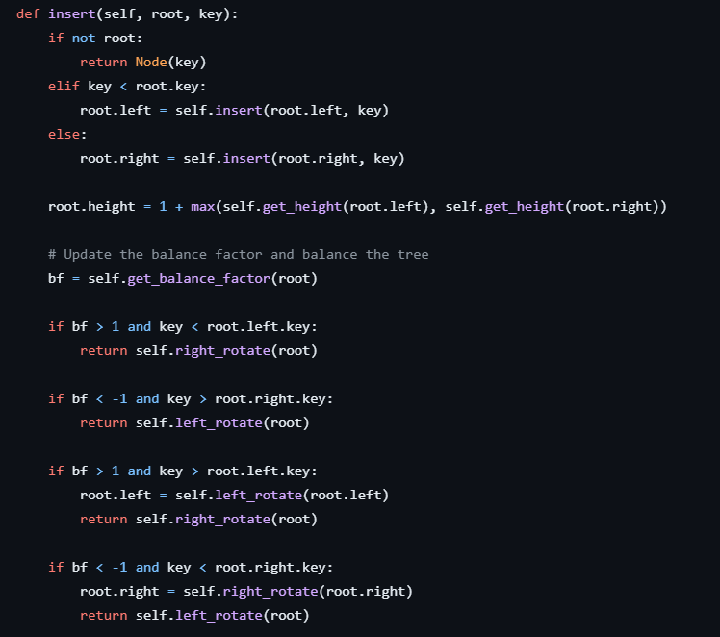
Insertion code

